Slide 1
The Other Cloud for .NET Developing with .NET 7 on AWS
Chris Woodruff

Slide 2

Chris Woodruff
cwoodruff@live.com
@cwoodruff
http://woodruff.dev

Slide 3

What do you need to start using AWS?

Slide 4

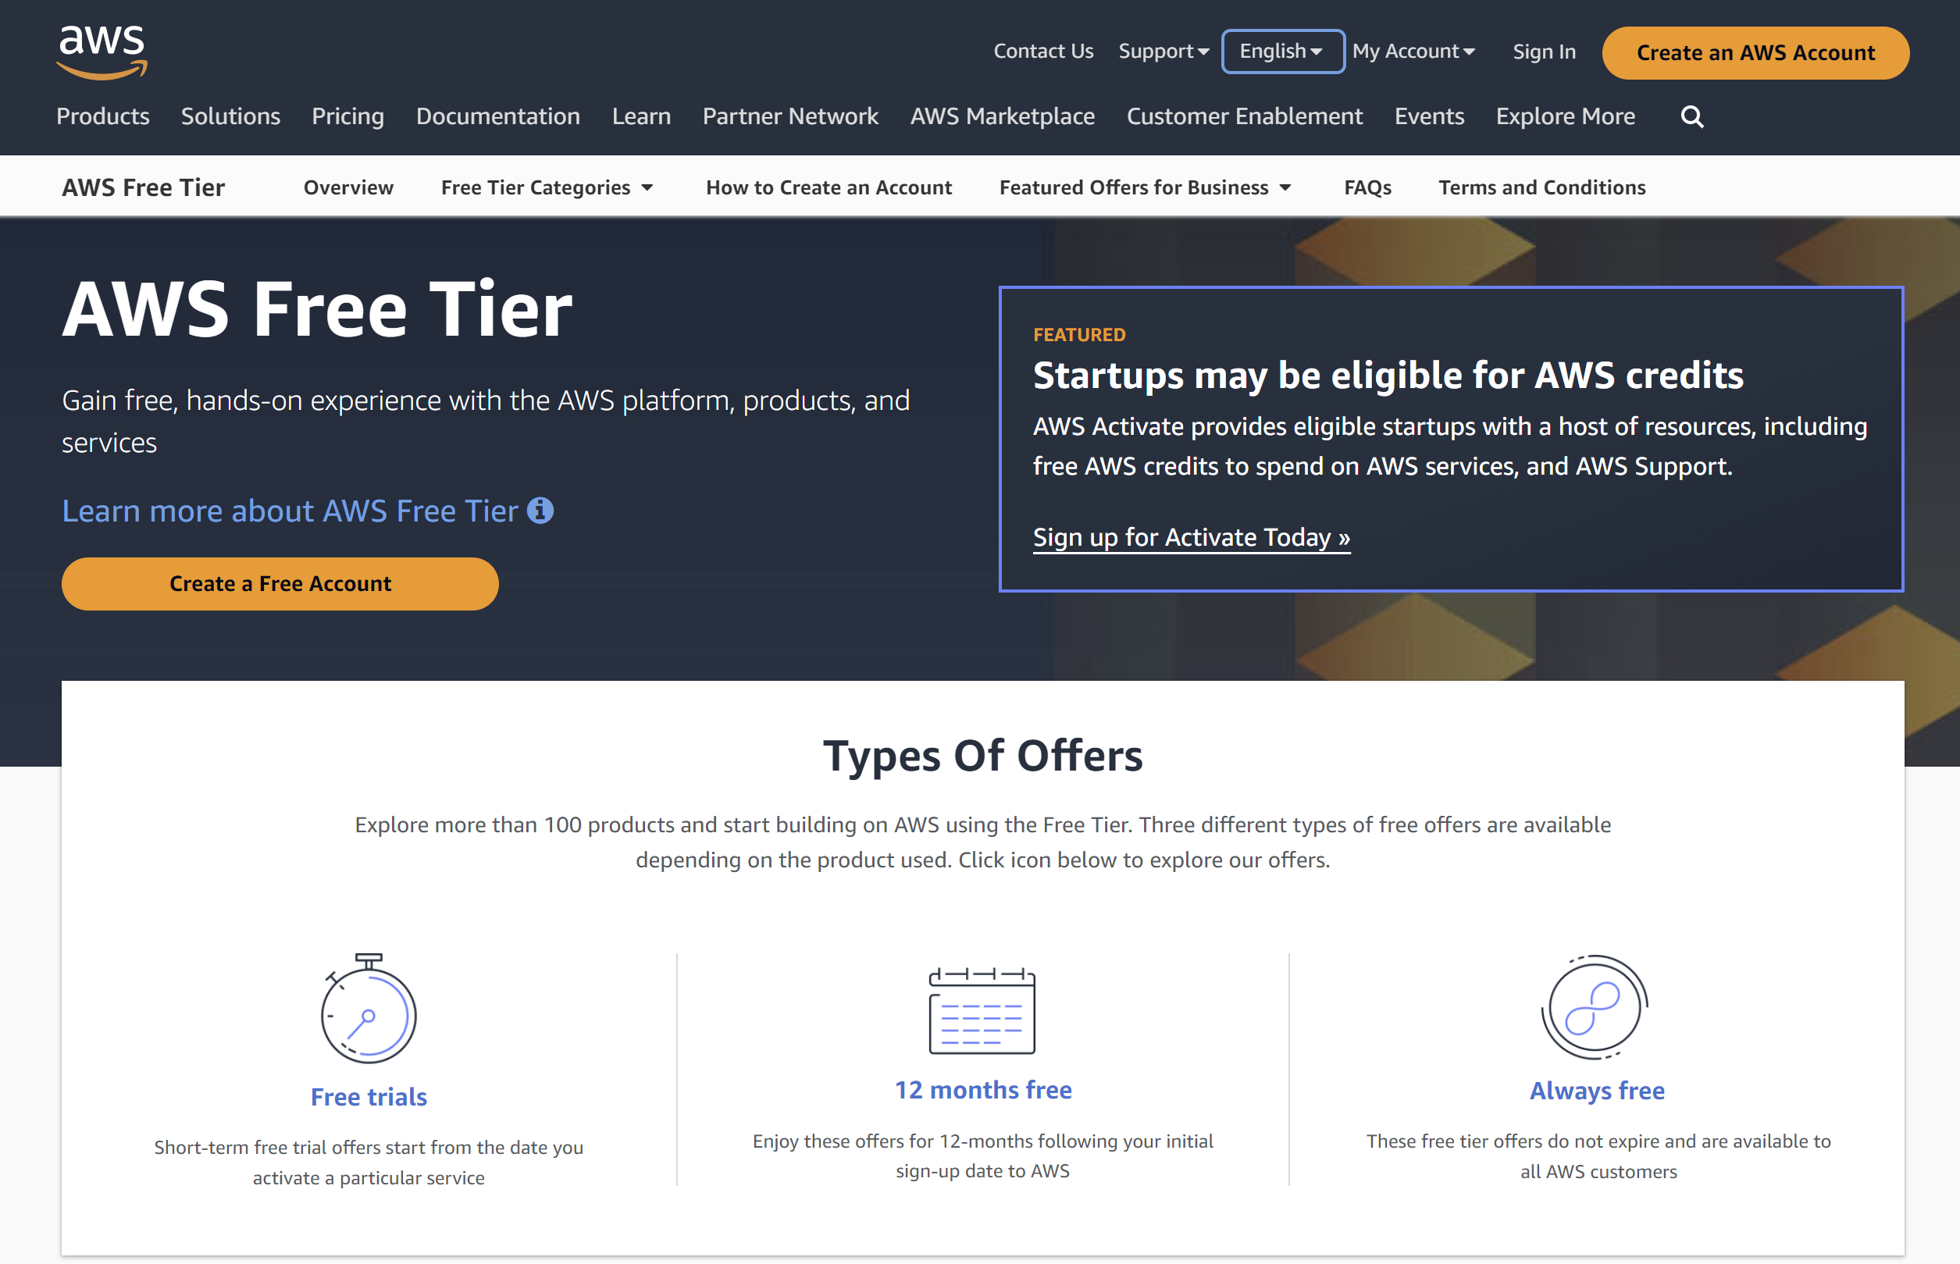
Sign up for an AWS Account

Slide 5
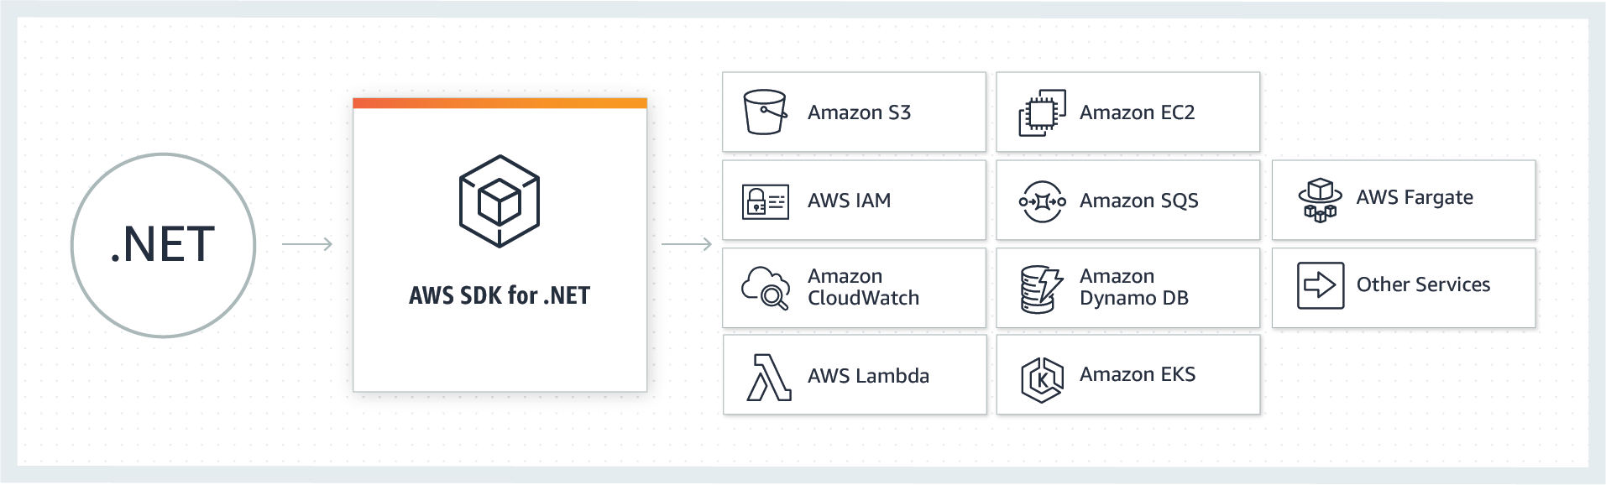
AWS SDK for .NET

Slide 6
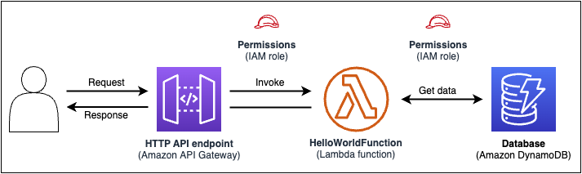
AWS Serverless Application Model (AWS SAM)
AWS SAM command line interface

Slide 7
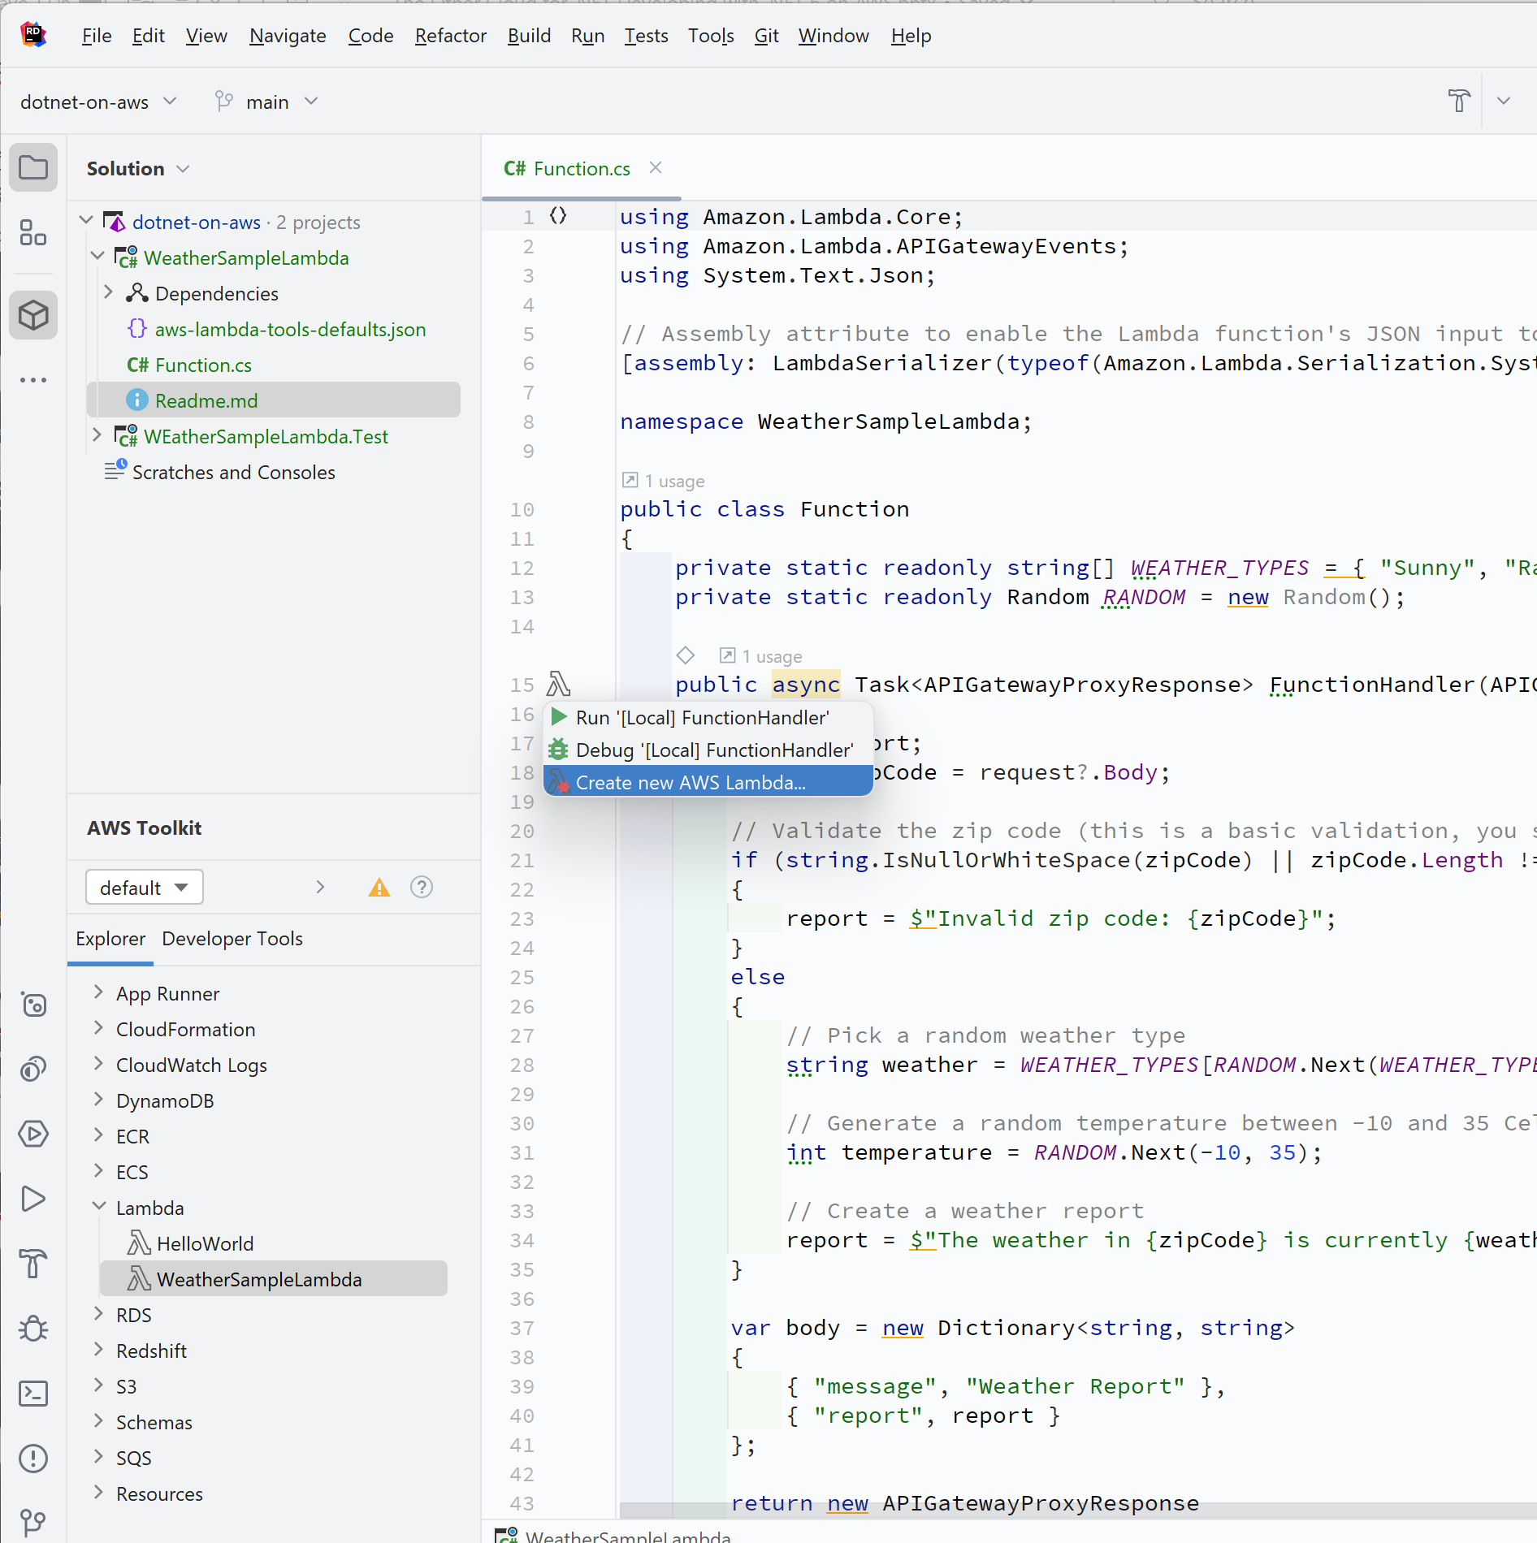
AWS Toolkit for your IDE
Visual Studio
JetBrains Rider
Visual Studio Code

Slide 8
AWS CodeCatalyst

Slide 9
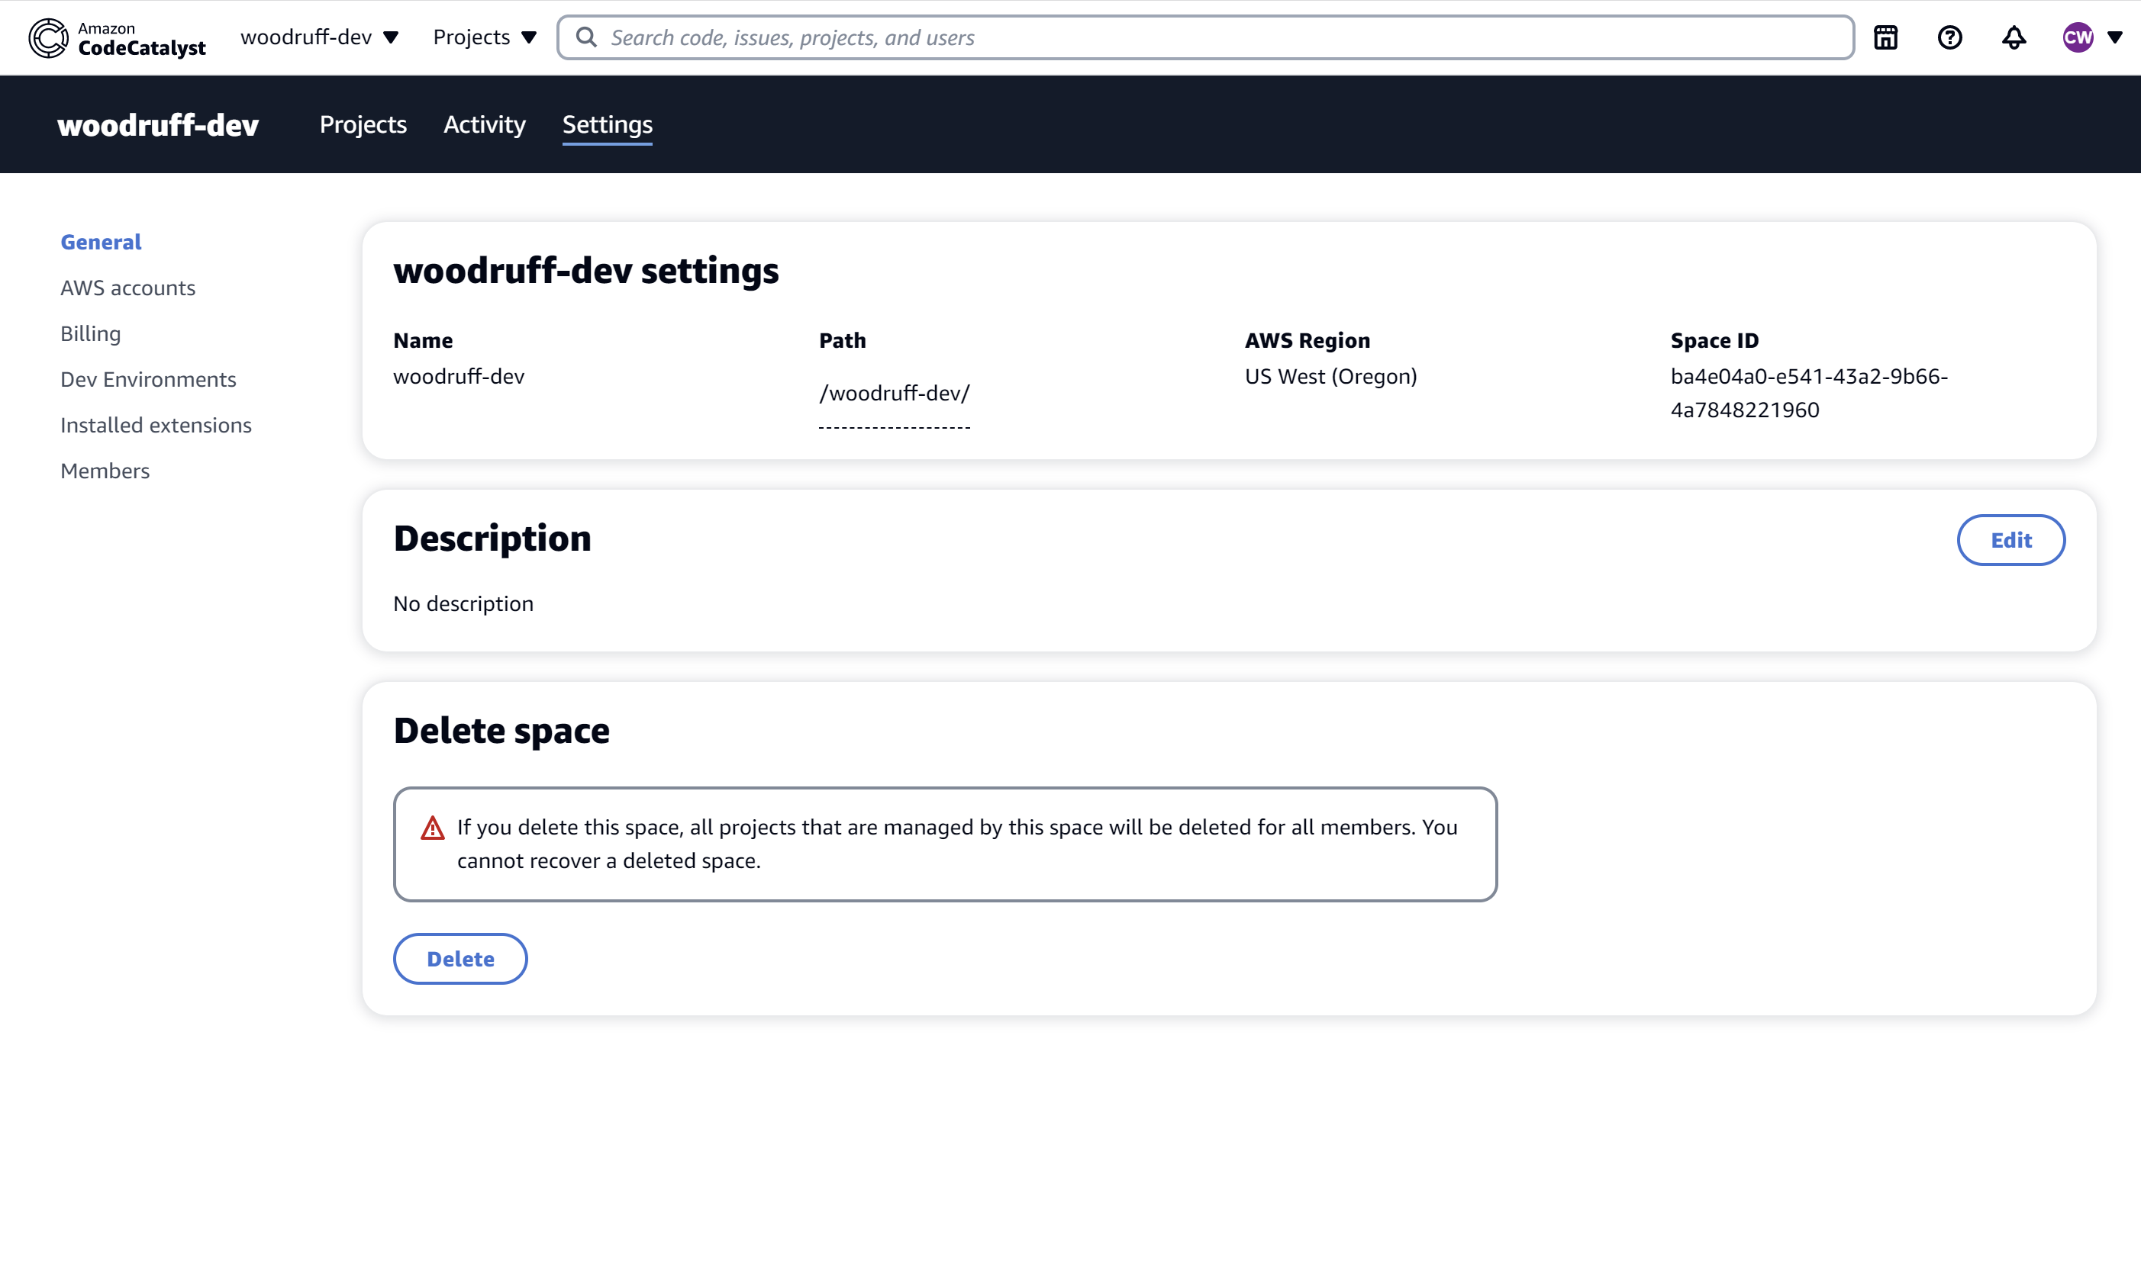
CodeCatalyst Space

Slide 10
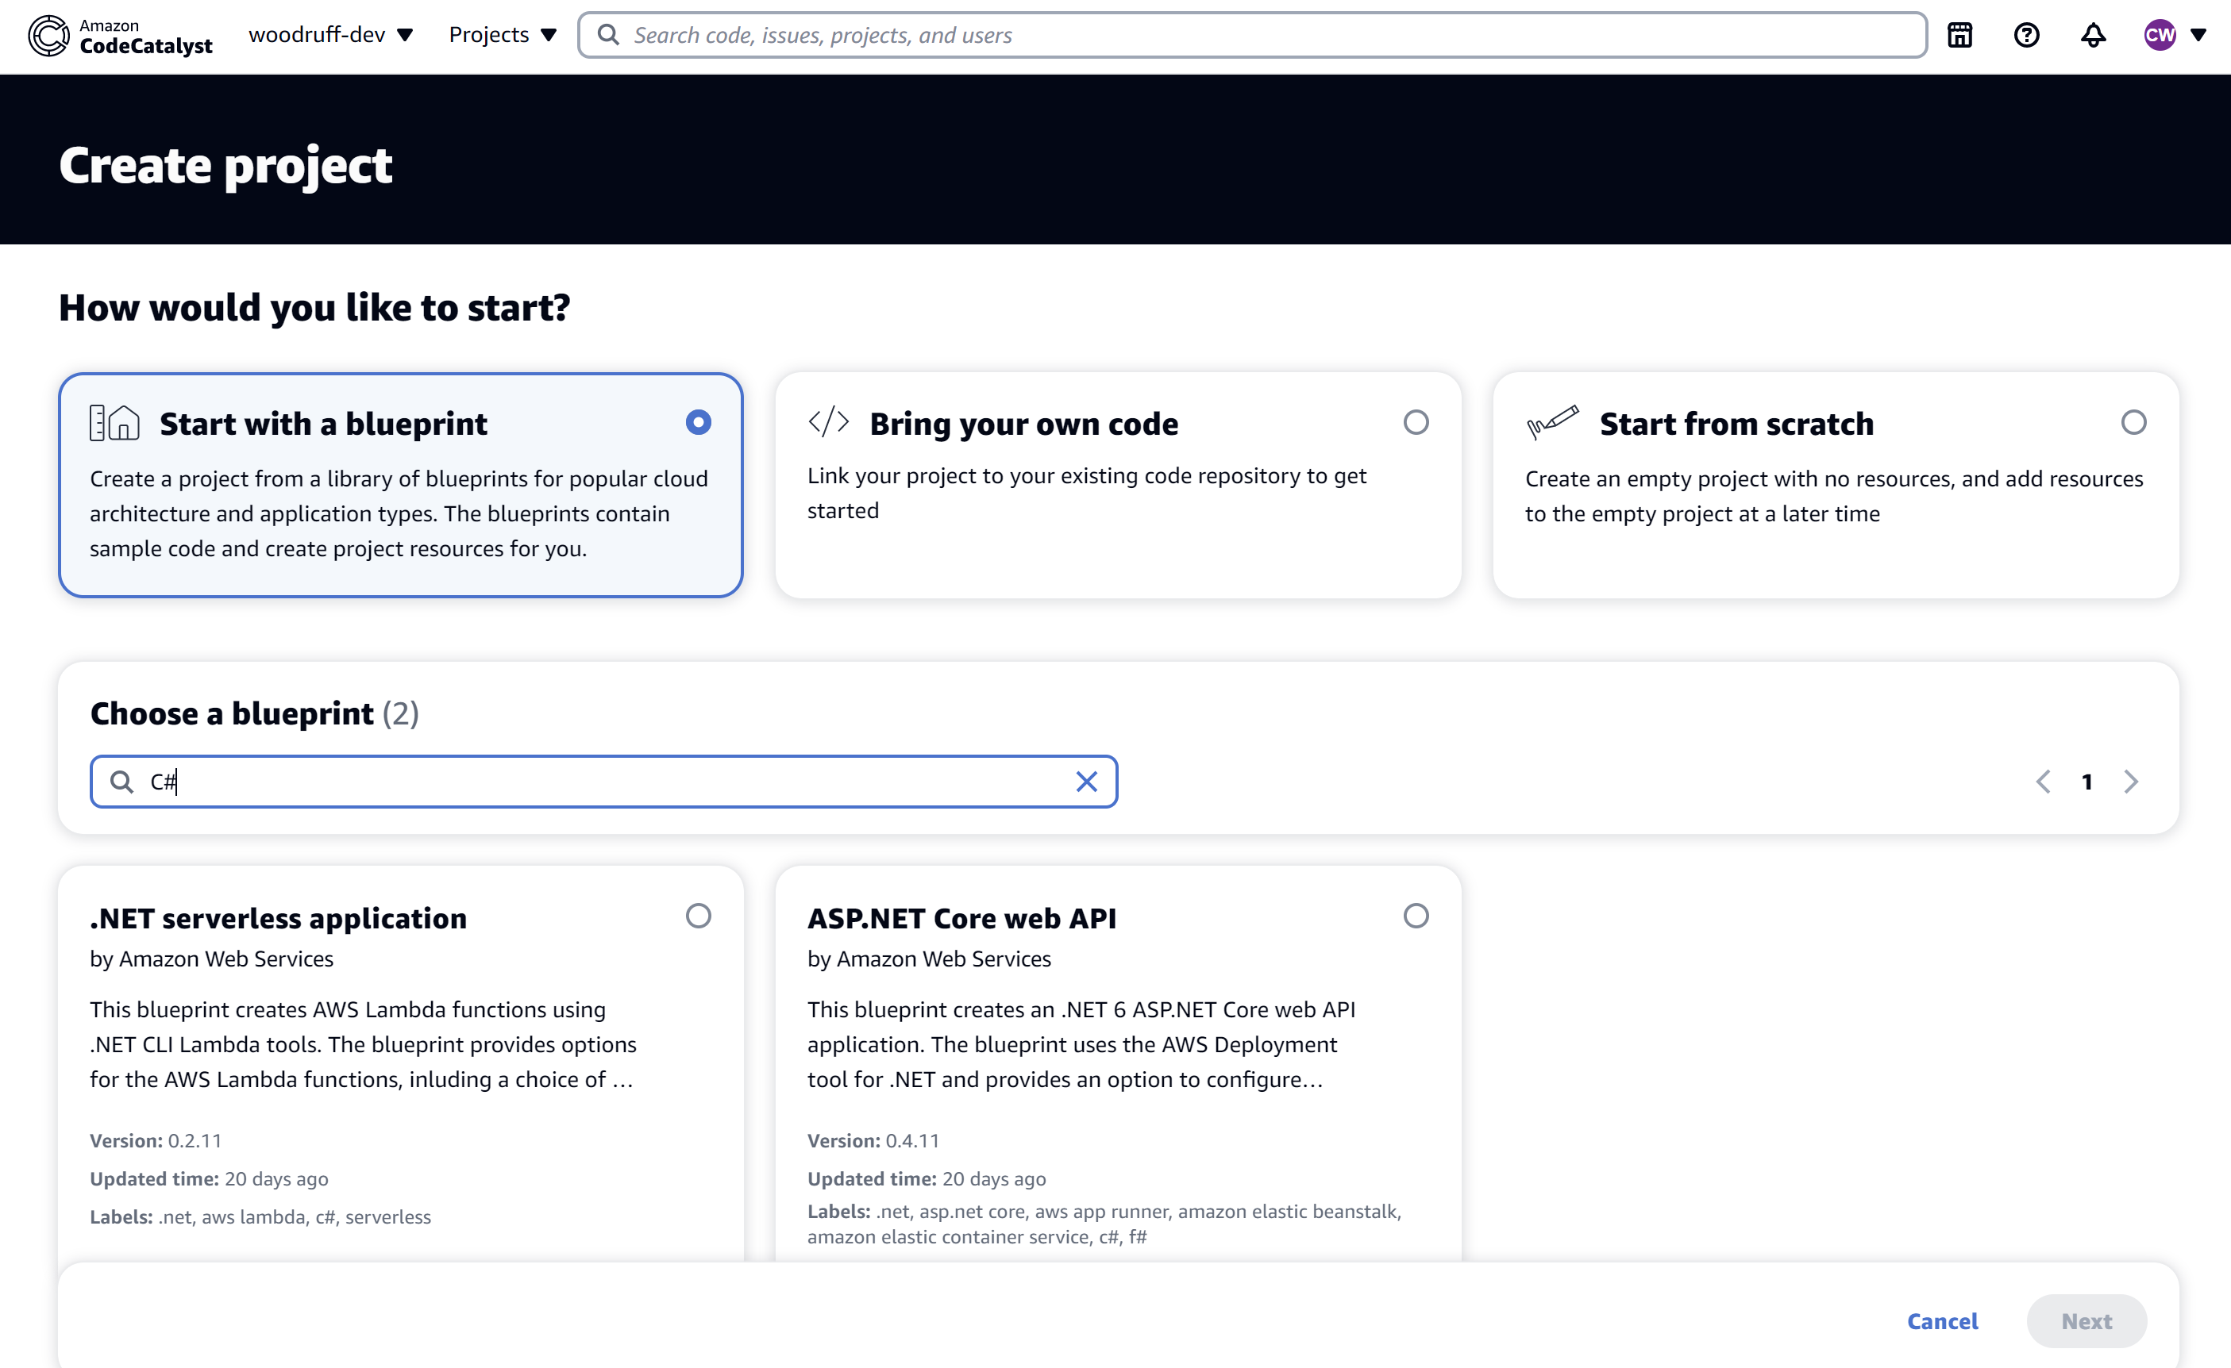
CodeCatalyst Project

Slide 11
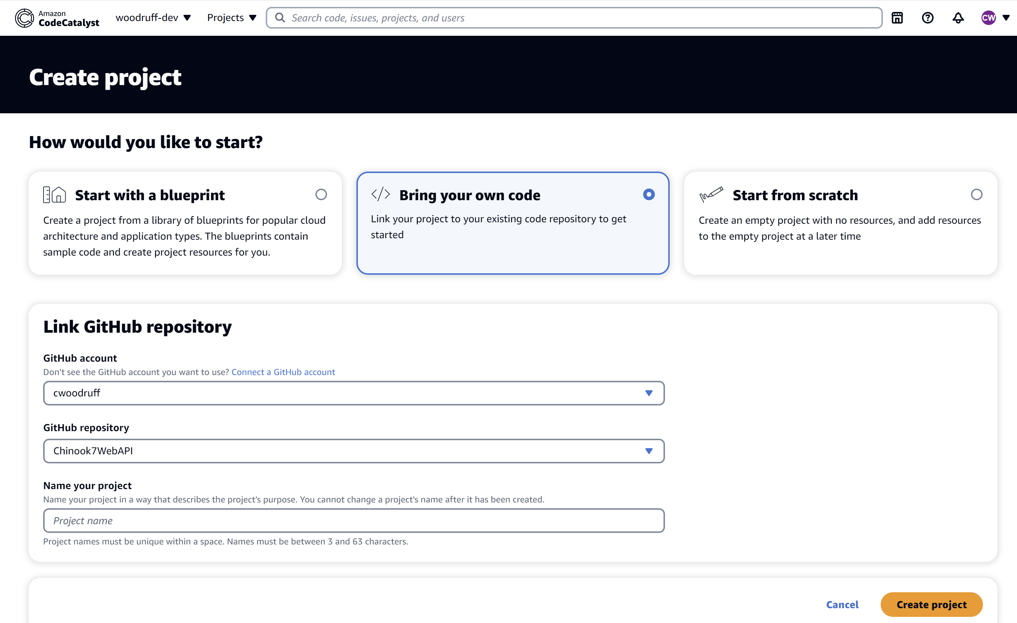
CodeCatalyst Project

Slide 12
Amazon RDS

Slide 13
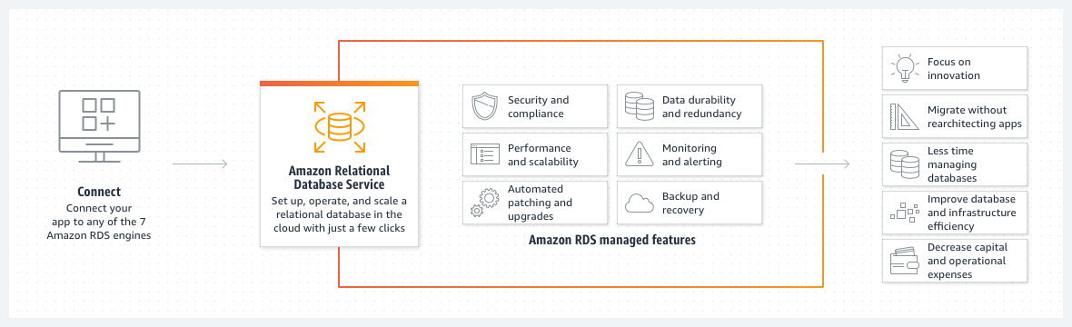
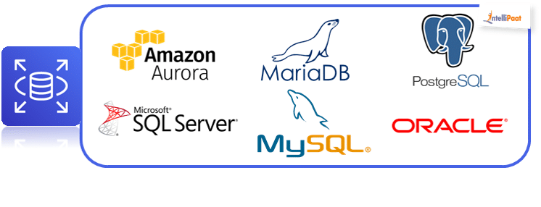
Amazon RDS

Slide 14
Amazon DynamoDB

Slide 15
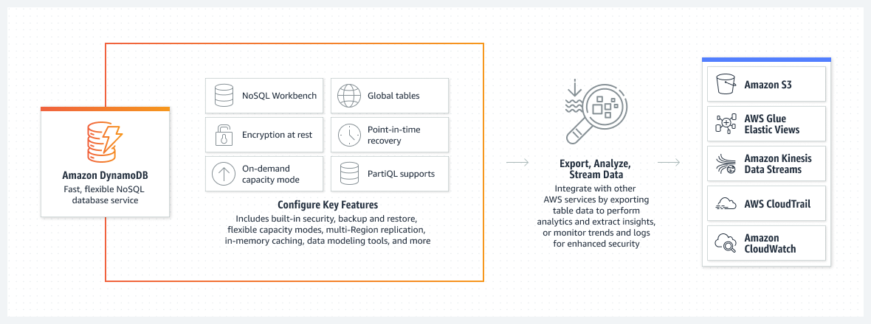
Amazon DynamoDB

Slide 16
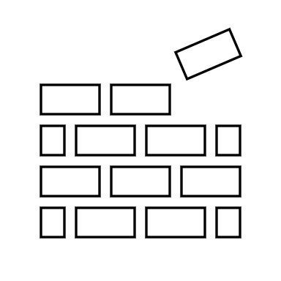
AWS CloudWhisperer

Slide 17
AWS Lambda

Slide 18


Slide 19
Deploying Lambda using DotNet CLI
dotnet lambda deploy-function WeatherSampleLambda --function-role user

Slide 20
AWS Microservice Extractor for .NET

Slide 21
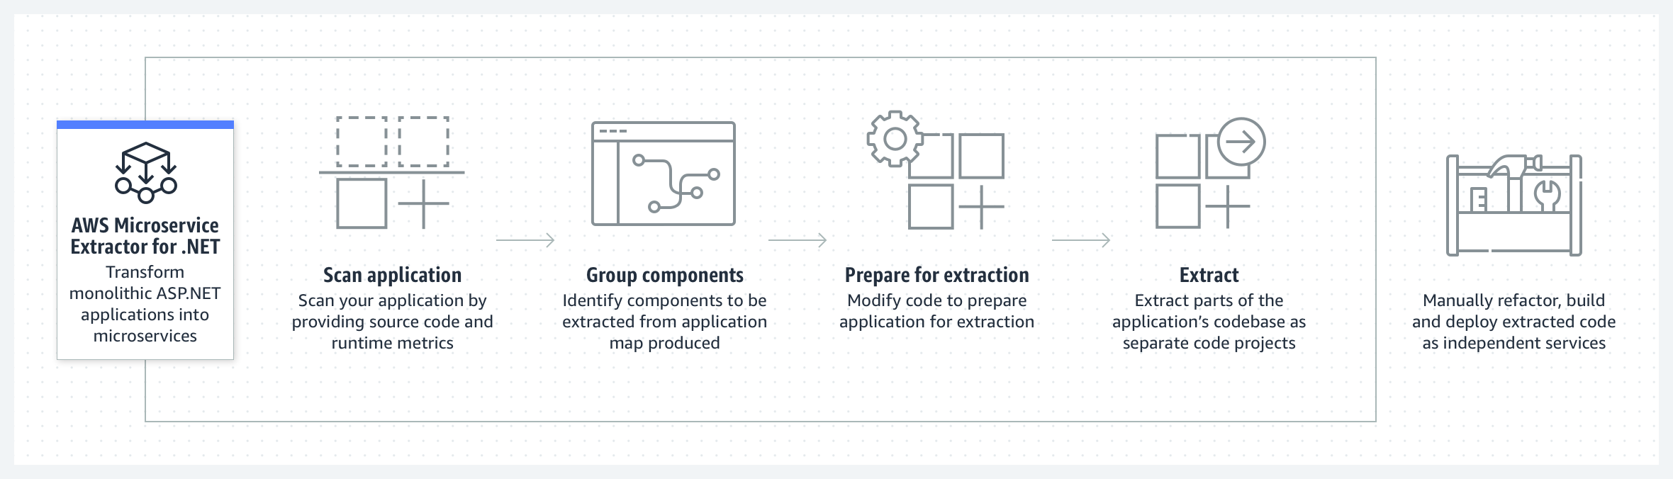
AWS Microservice Extractor for .NET

Slide 22
AWS Identity and Access Management

Slide 23
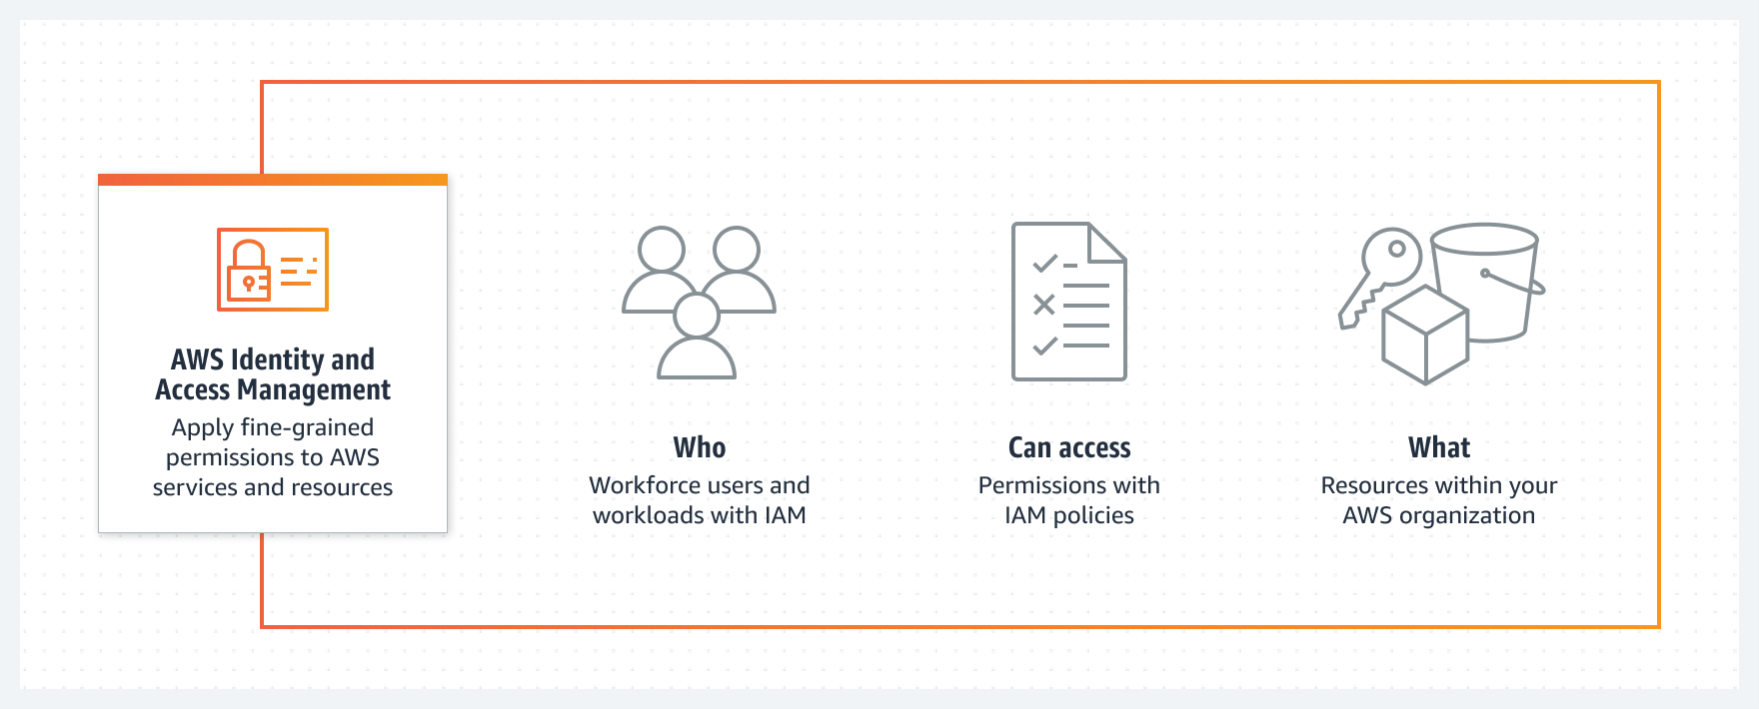
AWS Identity and Access Management

Slide 24
AWS Secrets Manager

Slide 25
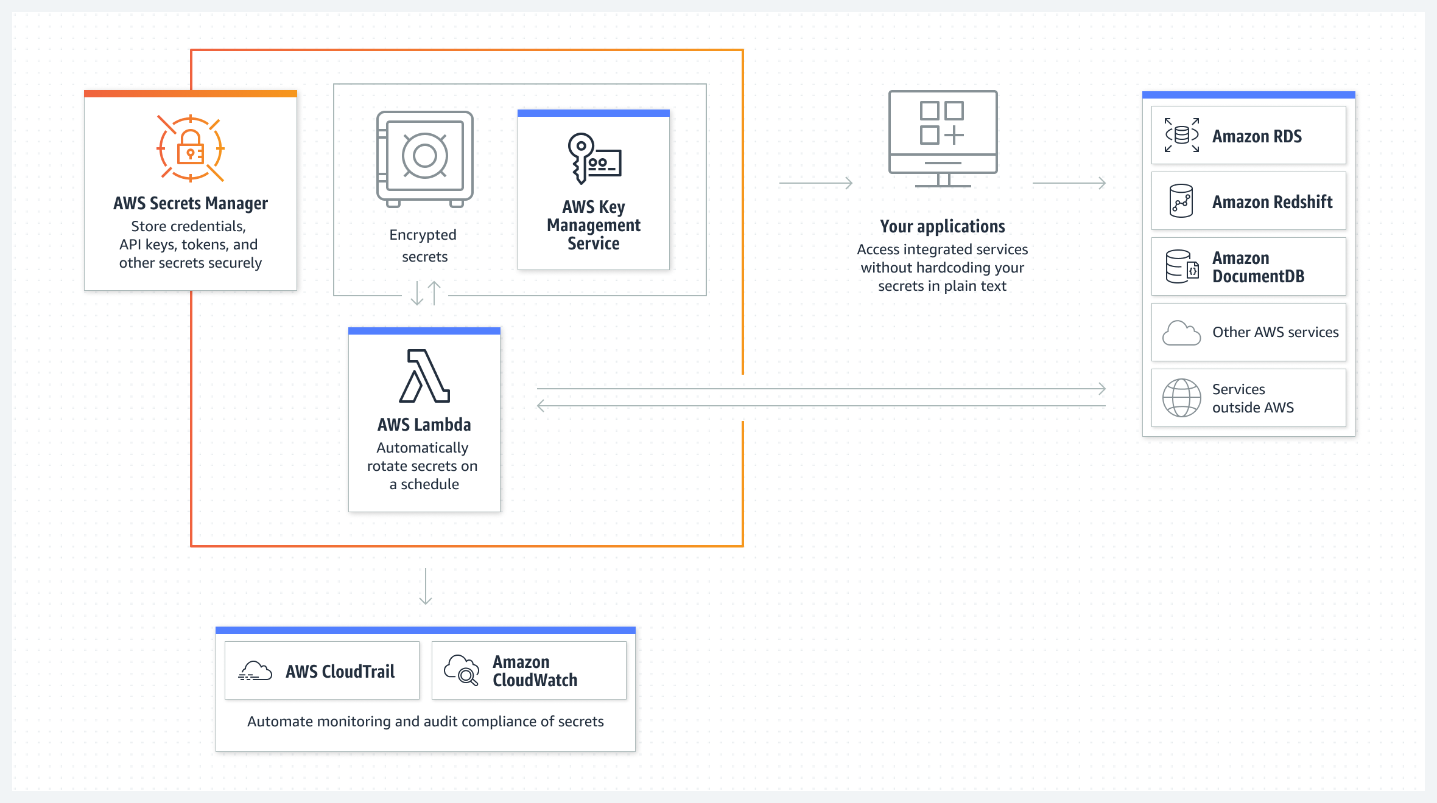
AWS Secrets Manager

Slide 26
public static string GetSecret() {
string secretName = "dev/myapp/config";
string region = "us-west-2";
string secret = "";
MemoryStream memoryStream = new MemoryStream();
IAmazonSecretsManager client = new AmazonSecretsManagerClient(RegionEndpoint.GetBySystemName(region));
GetSecretValueRequest request = new GetSecretValueRequest();
request.SecretId = secretName;
request.VersionStage = "AWSCURRENT";
GetSecretValueResponse response = null;

Slide 27
try {
response = client.GetSecretValueAsync(request).Result;
}
catch (Exception e) {
throw;
}
if (response.SecretString != null) {
return secret = response.SecretString;
} else {
memoryStream = response.SecretBinary;
StreamReader reader = new StreamReader(memoryStream);
string decodedBinarySecret = System.Text.Encoding.UTF8.GetString(Convert.FromBase64String(reader.ReadToEnd()));
return decodedBinarySecret;
}
}

Slide 28
AWS CloudWatch

Slide 29
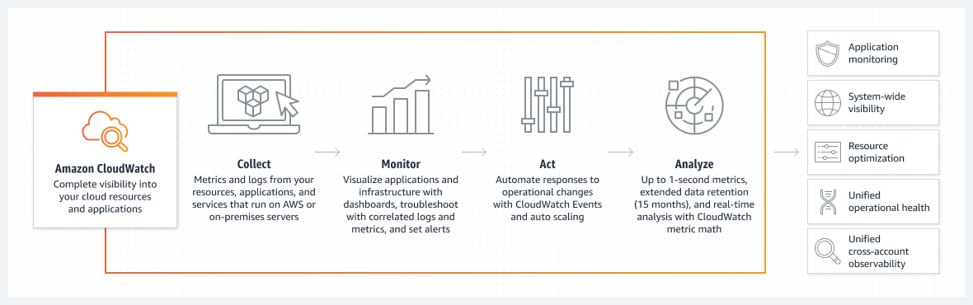
AWS CloudWatch

Slide 30
CloudWatch
How you can log data from C# to CloudWatch Logs
var awsAccessKeyId = "your access key";
var awsSecretAccessKey = "your secret access key";
var logGroupName = "your log group name";
var logStreamName = "your log stream name";
var client = new AmazonCloudWatchLogsClient(awsAccessKeyId, awsSecretAccessKey, RegionEndpoint.USWest2);
var request = new PutLogEventsRequest
{
LogGroupName = logGroupName,
LogStreamName = logStreamName,
LogEvents = new List<InputLogEvent>
{
new InputLogEvent
{
Message = "This is a test message",
Timestamp = DateTime.UtcNow
}
}
};

Slide 31
AWS Toolkit for .NET Refactoring

Slide 32
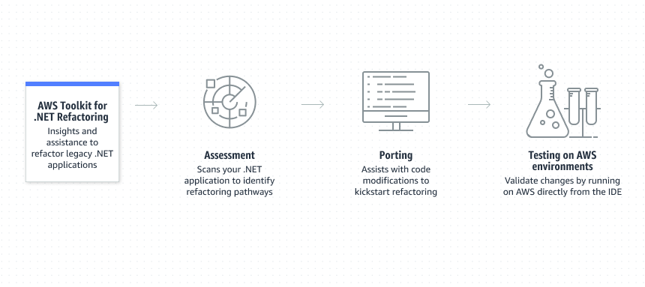
AWS Toolkit for .NET Refactoring

Slide 33

AWS CloudFormation

Slide 34
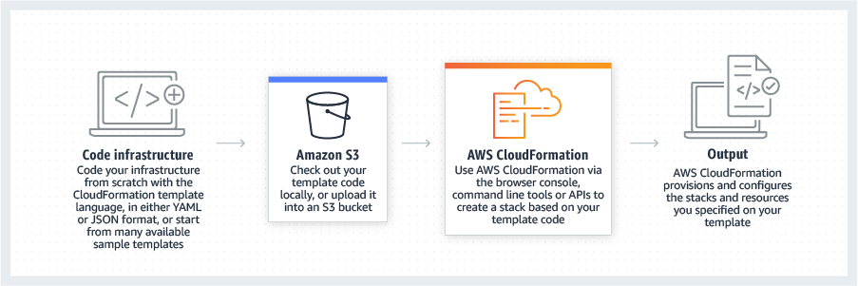
AWS CloudFormation
IaC (infrastructure as code)

Slide 35
AWS BeanStalk

Slide 36
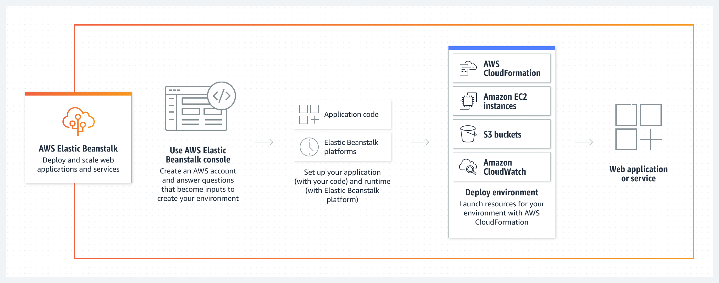
AWS BeanStalk
PaaS (platform as a service)

Slide 37
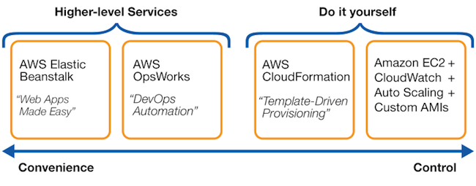
CloudFormation vs BeanStalk

Slide 38
AWS Load Balancing

Slide 39
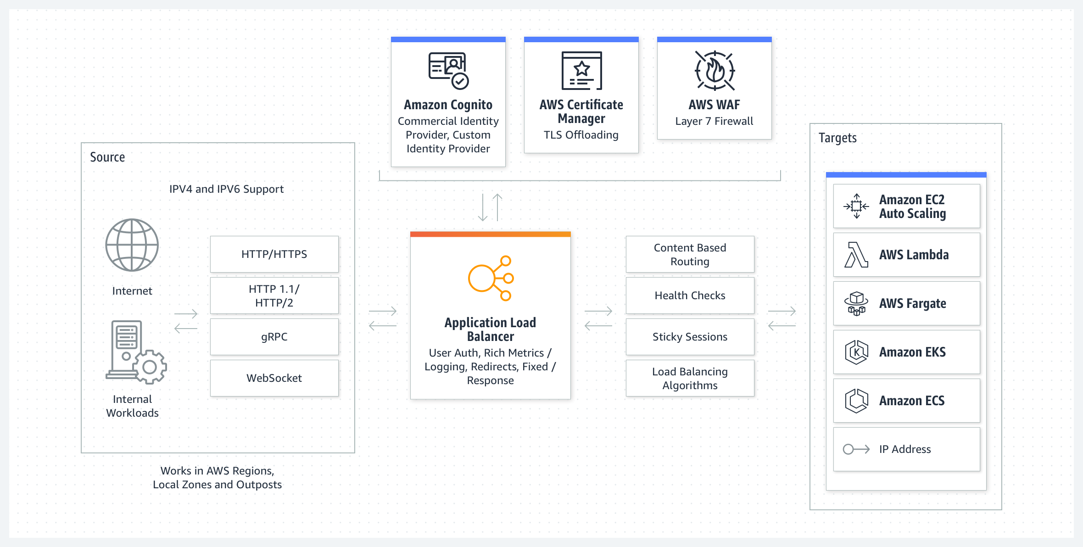
AWS Load Balancing

Slide 40
AWS App2Container

Slide 41
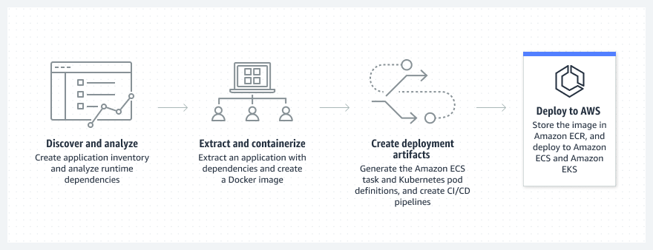
AWS App2Container

Slide 42
Q&A

Slide 43

Resources
https://aws.amazon.com/developer/language/net/
https://github.com/aws/dotnet
https://aws.amazon.com/sdk-for-net/
https://aws.amazon.com/sdk-for-net/
.NET Immersion Day
http://surl.li/hhrey

Slide 44
Thank you!!!
https://github.com/cwoodruff/dotnet-on-AWS-examples

